Slide 1
ASHRAE and Decarbonization
Ginger Scoggins, P.E., Fellow ASHRAE
2023-24 ASHRAE Society President
Notes:
I call this presentation “A pre-quel”. We are all familiar with pre-quells these days…it seems to be what is occurring when there is great interest in the background for current situations. Game of thrones now has a pre-quil, Yellowstone has a pre-quil with 1886, and Starwars has numerous pre-quil movies that show life before Darth Vader and Jaba the Hut.
So, I figured we should have an ASHRAE pre-quil to the 2050 decarbonization goals and, hopefully, in the future, I can do an ASHRAE sequel…..if I’m around long enough to do so! Somebody will do so, for sure. My goal today is to show that ASHRAE is “walking the talk” if you will, both in word and actions, and to set the stage for the future. Kent told us this morning of the activities of the ASHRAE TFBD – there are other efforts happening in ASHRAE as well which I want to make you aware of in this presentation.

Slide 2



ASHRAE Overview
Mission
To serve humanity by advancing the arts and sciences of heating, ventilation, air conditioning, refrigeration and their allied fields.
Vision
A healthy and sustainable built environment for all.
Industry Classification
Consulting Engineers
Contractors
Manufacturers
Manufacturing Representatives
Government, Health & Education
Design Build
Architects
Founded
in
1894
199 Chapters
15 Regions
5,500+
Student Members
400+
Student
Branches
      51,000+
      Members
      130+ Countries
Notes:
Thank you and good morning! On behalf of ASHRAE President Farooq Mehboob, our board of directors and ASHRAE’s more than 51,000 members around the world, thank you for inviting to be a part of this great event. It’s an honor to be here today.

Slide 3


Climate is Rapidly Changing
2015 UN Paris Agreement
2°C to 1.5°C
In 2015, the Paris Agreement
was adopted to limit the global temperature rise maximum at 2°C with a strong recommendation to retain it at 1.5°C.
2018 UN IPCC Recommendation
1.5°C
Information Source:
United Nations
IPCC Reports

Slide 4
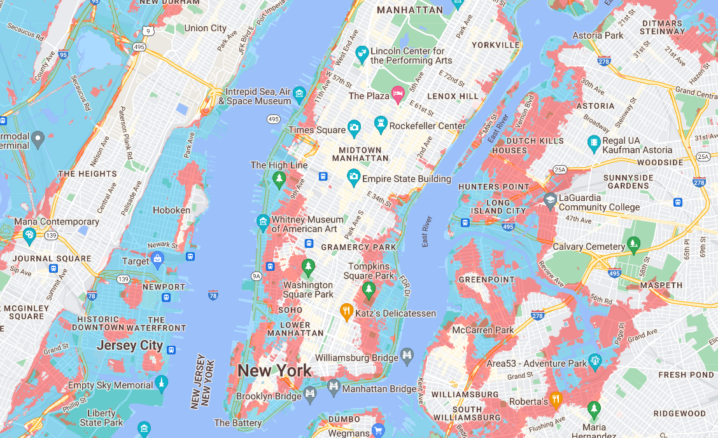


Why do we care?

Slide 5
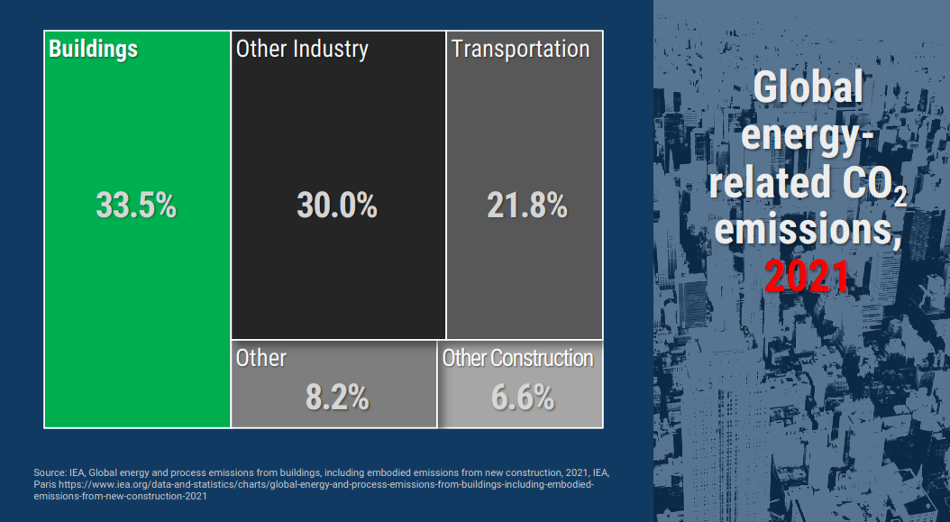

Slide 6
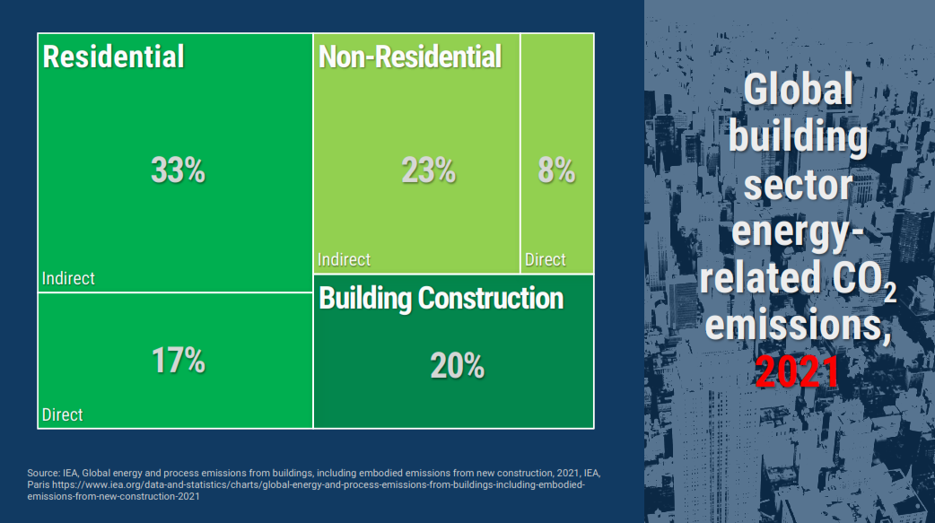

Slide 7



CLIMATE CHALLENGES
The global five hottest years on record are since 2016 and 2022 looks to be in the top 3 if not the hottest
Design conditions have already increased by 1 deg. C for heating and 0.5 deg. C for cooling since the early 1990s
Climate change will drive:
  Heating requirements down significantly while
  Substantially increasing cooling loads with 50 to 200% more cooling hours in some locations, with higher night-time temperatures.
Extreme weather –coastal and river flooding, wildfires, typhoons – could have greater impact.
ashrae.org/decarb

Slide 8
ASHRAE Task Force for Building Decarbonization
Worldwide building sector accounts for about 33% of carbon emissions and buildings remain a major sector that lacks sufficient mitigation policies
ASHRAE recognizes that our long-standing initiatives in energy efficiency should be expanded to building decarbonization
ASHRAE’s Task Force for Building Decarbonization formed in 2021 with 9 Working Groups and hundreds of volunteers involved
ashrae.org/decarb

Slide 9
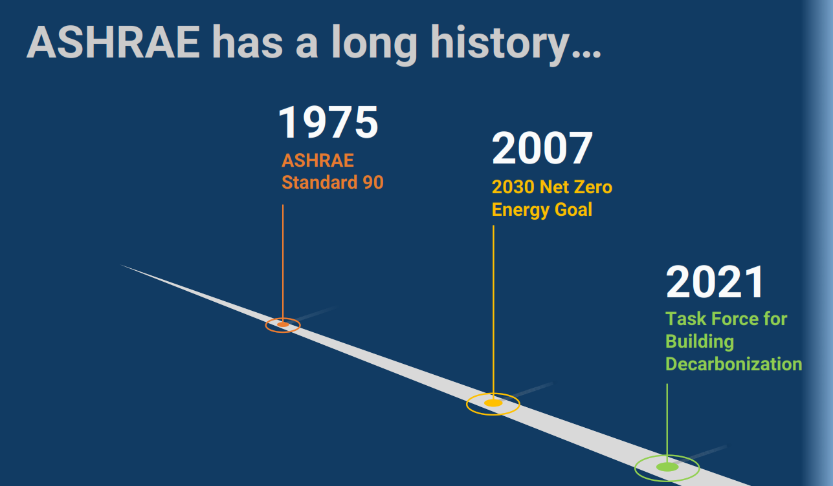
ASHRAE POSITION

Slide 10
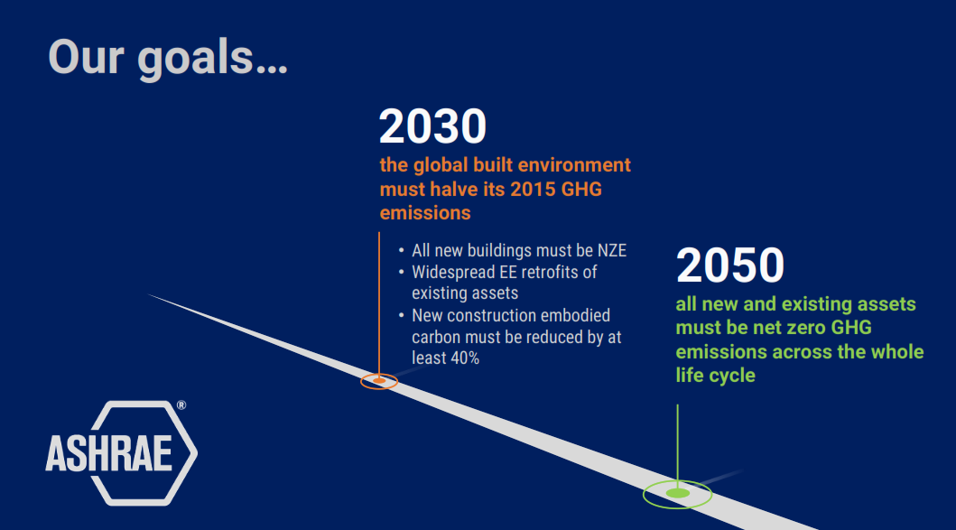
ASHRAE POSITION

Slide 11
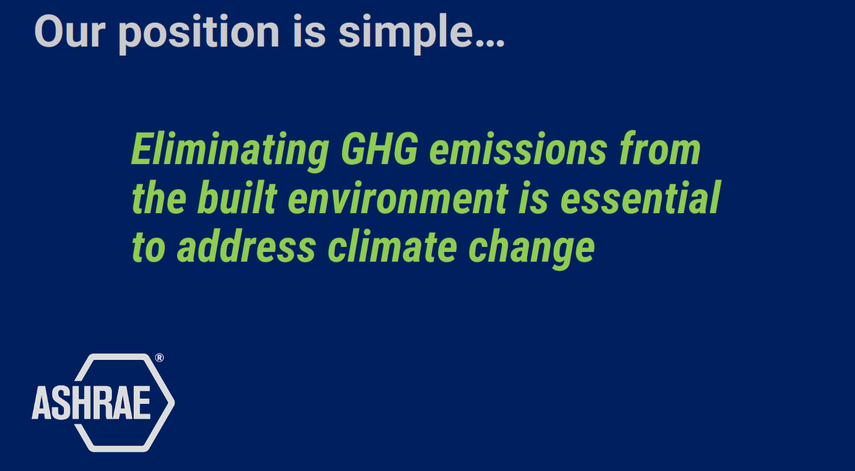
ASHRAE POSITION

Slide 12
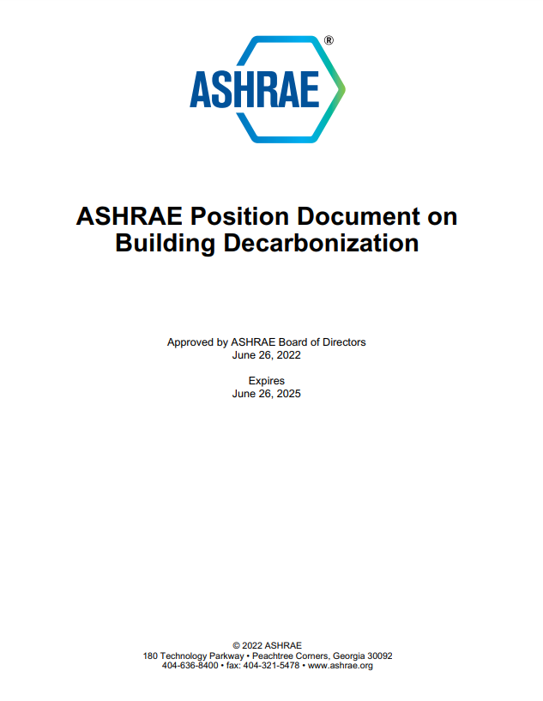
ASHRAE POSITION DOCUMENT OVERVIEW
Building Decarbonization strategies must consider healthy, safe and comfortable
environments, social impacts, resilience and sustainability
Operational GHG’s can be reduced by energy efficient measures.
Increasing stringency and enforcements of codes are critical
Whole-building LCA’s must be considered in future building codes to reduce embodied and operational carbon.
Building Performance Standards should be considered as a policy tool for existing building decarbonization
Buildings should be able to respond to real-time data from the power grid to reduce GHGs.

Slide 13
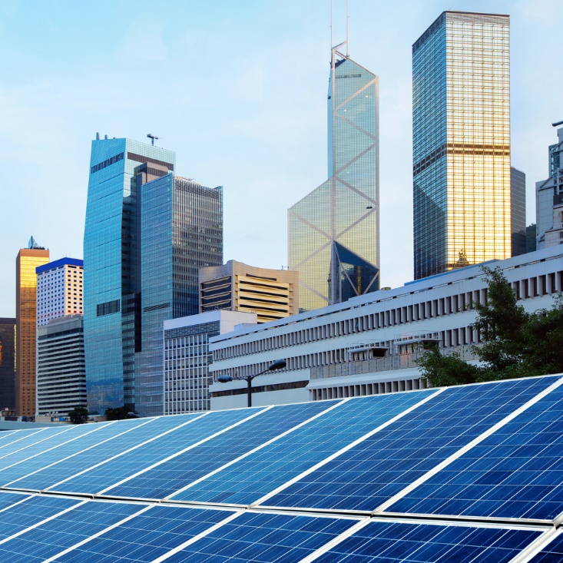
ASHRAE TASK FORCE FOR BUILDING DECARBONIZATION
Standards
  Operational carbon: 90.1, 90.2, 90.4, 100, IgCC, 105, 228P
  GHGs and Refrigerants: Standards 15 & 34
  Proposed NEW standard to also address embodied carbon/LCA: Evaluating Greenhouse Gas (GHG) and Carbon Emissions in Building Design, Construction and Operation
Training and ALI Education Courses
7 Guides to be issued on:
Building Decarbonization Retrofits Decarbonization Whole Life Design Guide for MEP Systems
Heat Pump Applications & Operation Hospital Decarbonization Design Guide
Building Performance Standards Grid Interactive Buildings for Decarbonization
ashrae.org/decarb

Slide 14
ASHRAE DECARBONIZATION RESOURCES
Building Performance Standards for Existing Buildings
  Standard 100 – Energy Efficiency in Existing Buildings
  Standard 211 – Commercial Building Audits
  Can be tailored for your jurisdiction
Technical Support
  Training and briefings specific to needs
  Non-commercial; apolitical
ashrae.org/decarb

Slide 15
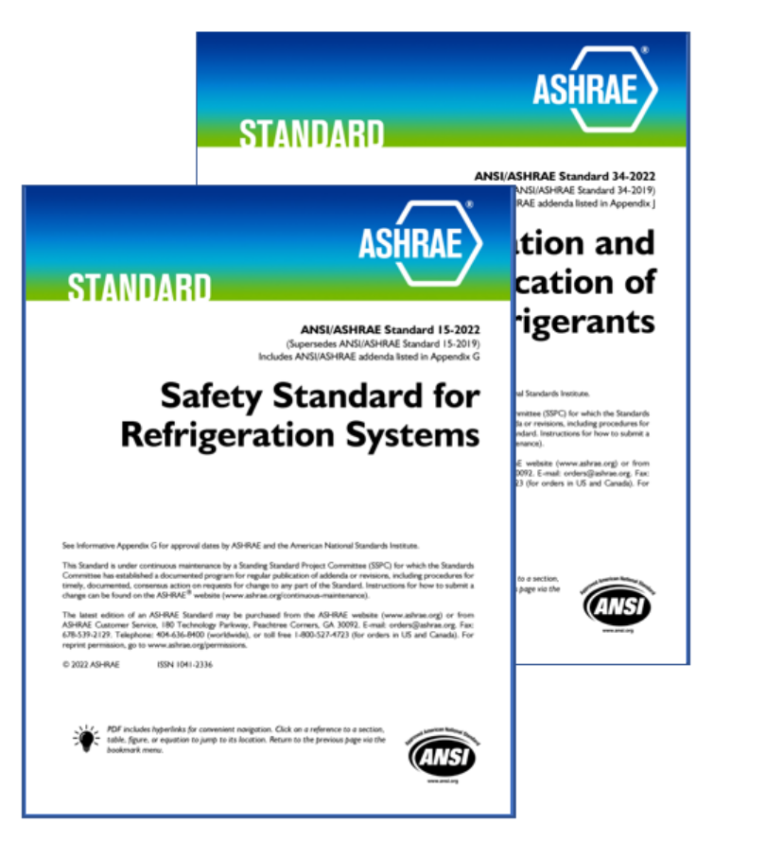
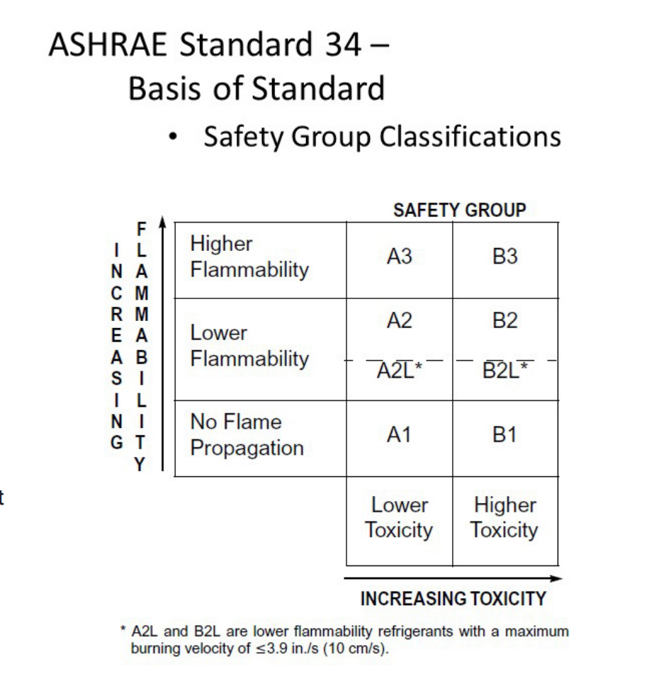
Refrigerant Management
Notes:
The use of refrigerants pose a huge issue in regards to climate change. As climate migration occurs due to climate changes, more persons will migrate to cities. The need for air-conditioning will increase as cities get hotter The use of refrigerants will increase. HFCs and HCFCs are an under-reported contributor to global warming. In fact, these gases are “climate super-pollutants,” with thousands of times the global warming potential of carbon dioxide. ASHRAE has been on the forefront of research and education regarding the use of refrigerants and changing the industry from the use of high-GWP refrigerants to low GWP refrigerants for the past decade, and will continue our work in this area in the future.

Slide 16

OTHER ASHRAE EFFORTS FOR BUILDING DECARBONIZATION
  Climate Change Position Document
  Handbooks (at least 30 Handbook chapters have materials related to climate change)
  Certification
  Evaluation of ASHRAE Scope 1,2,3 emissions as an organization
  FUNDING – ASHRAE BOD ALLOCATED $1.8 MILLION FOR DECARBONIZATION FOCUS ITEMS
Notes:
Chapter 36 Climate Change (2021 Fundamentals Handbook)
In 2019, TC 2.5 determined at least 30 Handbook chapters had material related to climate change

Slide 17

Ginger Scoggins, P.E., Fellow ASHRAE
2022-23 ASHRAE President-Elect
ashrae.org
Notes:
Welcome to the future, folks. It is conferences like these that will help us all get to where we need to be on this important topic. We remain ready to lead the building industry around the world into transforming our building stock into one that is sustainable, resilient, and healthy. The choices made today can lock us into the sustainability path of our future. We are here to be part of the solution and we are up to the challenge.
So, in closing, I look forward to the sequel of our main event…when, after 2050, we are having conversations in the future of how we, as an industry, addressed the impact of the built environment on climate change similar to how we are now touting our efforts from 1975 regarding the energy crises.
Thank you

Slide 18
Ginger Scoggins, P.E., Fellow ASHRAE
2022-23 ASHRAE President-Elect
ashrae.org

