Slide 1

Welcome
ASHRAE NY Chapter
February Dinner Meeting
Code Discussion: New York State / New York City
Host: SY 2021-2022 President – Benjamin Rodney

Slide 2


John Addario - Bio
Director of the Division of Building Standards and Codes at Department of State
The Division of Building Standards and Codes administers New York’s Uniform Fire Prevention and Building Code and State Energy Conservation Construction Code, providing technical assistance, delivering educational courses, and overseeing the enforcement practices of over 1600 local governments around the state. The Division also serves as secretariat to New York’s State Fire Prevention and Building Code Council.
John has been employed by the Department of State since 2000. John is a Professional Engineer who has over 17 years’ experience in the private sector in building HVAC and systems design, energy analysis and audits, building energy conservation measure design and implementation, budgetary cost estimates and project management.

Slide 3
Agenda:
Introduction
Overview of NYS Codes
Climate Change and the NYS Codes
Notes:
On your screen you will see today’s Agenda
We will be talking about…

Slide 4
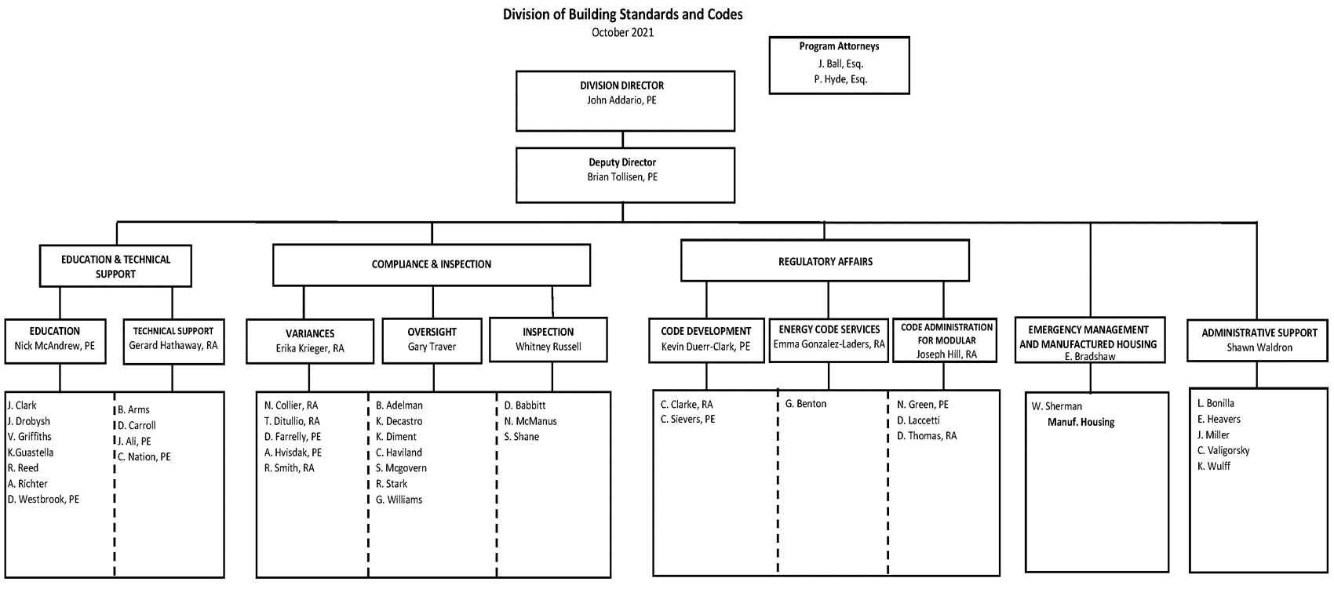
Division of Building Standards and Codes

Slide 5
Division of Building Standards and Codes – Overview
The Division of Building Standards and Codes is comprised of nine units, including:
  Energy Code Services Unit
  Code Development Unit
  Educational Services Unit
  Technical Support Unit
  Variance Unit
  Oversight Unit
  Direct Enforcement Unit
  Modular Unit (Factory Built Buildings)
  Emergency Management Unit/Manufactured Housing Unit

Slide 6
Uniform Code
Executive Law § 377
Title 19 NYCRR
Part 1219-1228
Incorporated by Reference
2020 NYS Codes
Effective May 2020
Other Reference Standards
Notes:
And as a reminder for everyone here, the Uniform Code isn’t only found in a code book.
The Department of State is sometimes required to amend the code between code cycles.
When this happens, the amendments are, in some way, shape, or form, addressed in the NYCRR.
So, after the effective date of the new codes, any amendments to the codes will be incorporated into the NYCRR until the next code cycle comes along.
At the next code cycle, these amendments are normally incorporated into the new code books
So, this is the major reason that you really need to sign up for E-Bulletins.
You need to stay current.

Slide 7
Energy Code
Energy Law Article 11
Title 19 NYCRR
Part 1240
Incorporated by Reference
2020 NYSECC Codes
Effective May 2020
Other Reference Standards
Notes:
And as a reminder for everyone here, the Energy Code isn’t only found in a code book.
The Department of State is sometimes required to amend the code between code cycles.
When this happens, the amendments are, in some way, shape, or form, addressed in the NYCRR.
So, after the effective date of the new codes, any amendments to the codes will be incorporated into the NYCRR until the next code cycle comes along.
At the next code cycle, these amendments are normally incorporated into the new code books
So, this is the major reason that you really need to sign up for E-Bulletins.
You need to stay current.

Slide 8
Building Codes of New York State
Article 18 of Executive Law Article 11 of Energy Law
Uniform Code Energy Code
State Fire Prevention and Building Code Council
“Building Codes of New York State”
Notes:
Two laws that make the Code Council the governing body for the Uniform Code and the Energy Code

Slide 9
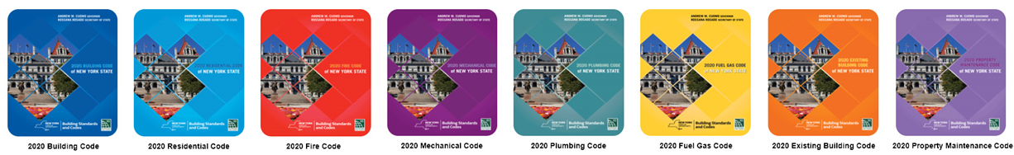
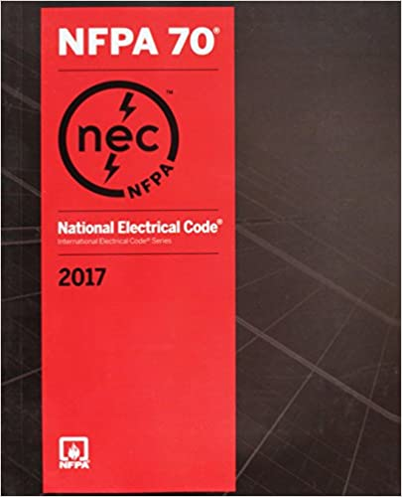
Building Codes of New York State - The Uniform Code
Mandatory Statewide, except jurisdictions larger than 1 million residents (i.e., NYC)
Local jurisdictions enforce the codes
Local jurisdictions may adopt more restrictive local standards upon approval from the Code Council
2017 Electrical Code
Notes:
State Agencies/Buildings under the custody of a State Agency
Currently on the 2018 I-Codes and ASHRAE 90.1-2016

Slide 10
Climate Change & Building Codes
Notes:
Overlap in the Building Codes & Energy Code
Electric ready
PV Systems
Equipment

Slide 11
July 18, 2019
New York State Passes State Climate Law
A plan signed into law to address climate change & net zero emissions
Notes:
The Climate Leadership and Community Protection Act (CLCPA)

Slide 12
Recommendations from the EE&H Panel
Improve Energy Eff. and Resiliency
  Adoption of the stretch code statewide – 2023 stretch code
Require Energy Benchmarking on large buildings
Energy Disclosure at sale of building, residential and commercial

Slide 13
Recommendations from the EE&H Panel
Electric new construction code (ban on gas/oil equipment for space and water heating) – in homes starting in 2025

Slide 14
Recommendations from the EE&H Panel
Ban on gas/oil replacements (at end of useful life) of heating/hot water equipment – in homes starting in 2030*
Require lighting upgrades to current Energy Code standards and periodic energy audits for commercial buildings larger than 25,000 sq. ft.

Slide 15
Lower global-warming potential (GWP) Refrigerants
Use A2L refrigerants that are mildly flammable/in leu of A1 – Zero Flammability
Current barriers in code for A2L refrigerants
Proposals made to the 2024 I-Codes

Slide 16
Climate Action Council Draft Scoping Plan
https://climate.ny.gov/Our-Climate-Act/Draft-Scoping-Plan
Public Comment Period
New Yorkers are encouraged to comment on the draft scoping plan during the 120-day public comment period, beginning January 1, 2022.
https://nyserda.seamlessdocs.com/f/DraftScopingComments
Notes:
Public comments can be submitted via the online public comment form, via email, and via U.S. mail. In addition, the Council will hold at least six public hearings across the State, both in-person and virtual, which will follow all appropriate COVID-19 health and safety guidelines. More details about the public hearings will be made available in early 2022.

Slide 17
2022 Governor’s State of the State
Governor Announces Plan to Achieve 2 million Climate-Friendly Homes By 2030
  2 million climate-friendly, electrified or electrification-ready homes by 2030

Slide 18
2022 Governor’s State of the State
  Require zero on-site greenhouse gas emissions for new construction no later than 2027
  Mandate energy benchmarking for large buildings, making it easier to track energy-efficiency improvements over time

Slide 19
2022 Governor’s State of the State
Incorporate achievement of New York State's greenhouse gas reduction objectives in developing the new construction code
Update building code cost-effectiveness criteria to account for the full lifetime of installed equipment
Expand the NYS Code Council to include the President and CEO of NYSERDA and the DEC Commissioner

Slide 20
Proposed Advanced Building Codes,
Appliance Equipment Efficiency
Proposed Legislation – Advanced Energy Code & Appliance Standards
Modifies the Energy Law
Gives the NYS Code Council flexibility of updating the energy code to align with climate change issues, electrification, and carbon issues.

Slide 21
How to Stay Updated

Slide 22
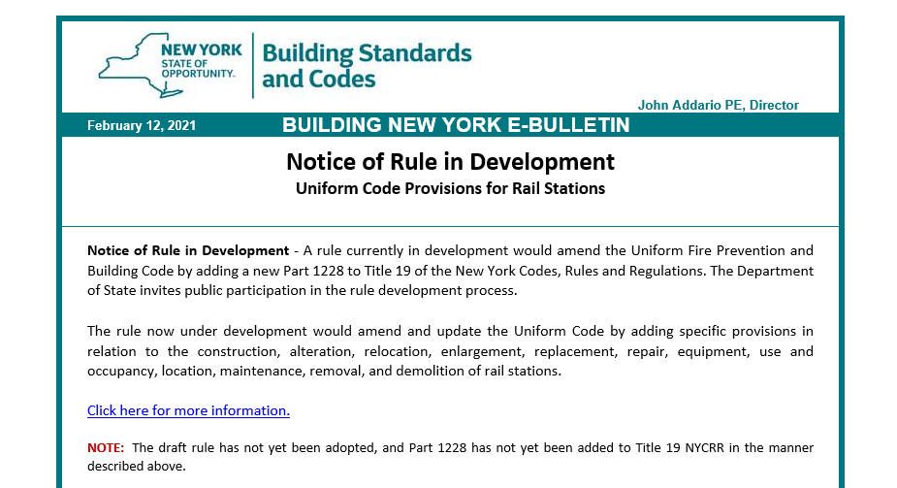
Building New York E-Bulletin

Slide 23
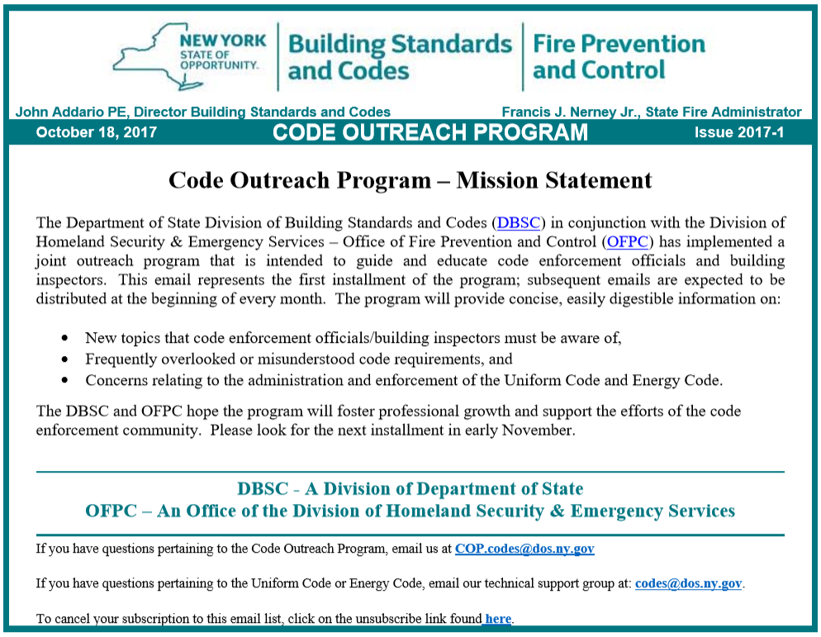
Code Outreach Program
Notes:
This form of outreach is provided by the Division in cooperation with OFPC.

Slide 24
Code Outreach Program
Over 50 published
Delivered monthly
Archived on our website
Sign up:
  Homepage
  Code Outreach Program
  Follow the instructions
Notes:
You can think of the Code Outreach Program, as the Technical Bulletin’s prolific little brother
The COPs are delivered to via email, somewhere around the beginning of every month.
If you haven’t signed up yet,
just go to the Division’s homepage,
click the link on the right, that says Code Outreach Program,
and then follow the instructions.
(click next)

Slide 25
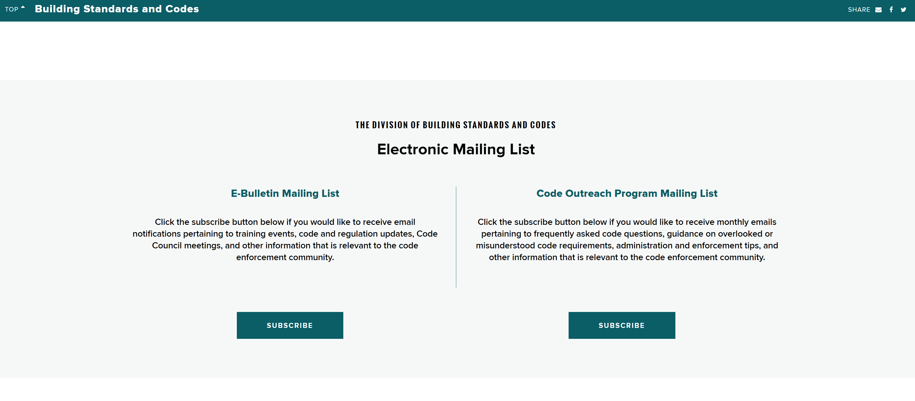

Building New York E-Bulletin
Sign up: https://dos.ny.gov/building-standards-and-codes
Notes:
If you haven’t signed up yet,
just go to the Division’s homepage,
click the link on the right, that says Code Outreach Program,
and then follow the instructions.
(click next)

Slide 26
NYC v. NY State Energy Code:
The future of the Energy Code and its relation to LL97
February 17, 2022
presented by
Gina Bocra, RA, LEED Fellow
Emily Hoffman, PE, CEM

Slide 27

Emily Hoffman
Director of Energy Code Compliance with the NYC Department of Buildings
Much of her work is also educating the public on energy code compliance and researching technical issues relating to energy code.
Emily is involved on code development on the state and national level, serving as the Vice Chair of the 2024 IECC commercial consensus committee, ASHRAE committees (Std 90.1 ECB, Std 229) and the NYSERDA Stretch Code Advisory Committee.
Her previous experience involves energy modeling, energy auditing, and commissioning. She is a Professional Engineer, Certified Energy Manager, and holds a Bachelors and Masters in Mechanical Engineering.

Slide 28
Agenda
2020 NYCECC –
  Changes from NYSERDA Stretch Code
  Changes from NYC Advisory Committee
Future Energy Codes
  LL32 of 2018
  NYC Pilot Program
NYC Building Electrification Law
LL97 Updates

Slide 29
New Provisions
Adopted from the NYSERDA NYStretch Energy Code - 2020

Slide 30
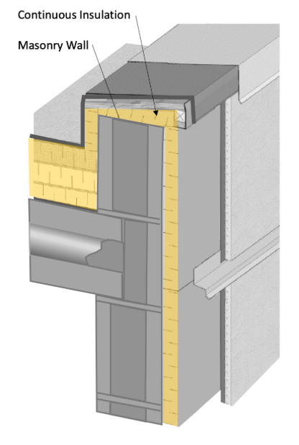
NY Stretch - Envelope
Summary of Changes to envelope:
  More stringent insulation requirements
  Mandatory thermal break for balconies and parapets
      Wrap balcony/parapet in continuous insulation
      OR provide R-3 thermal break
  Air barrier commissioning on buildings >10,000 square feet, similar to Air Barrier Continuity Plan
Photo source: BC Hydro Building Envelope Thermal Bridging Guide V. 1.2 - Sept. 2018
Notes:
Now, on to the NYStretch Code. Again, this code is available on NYSERDA’s website.

Slide 31
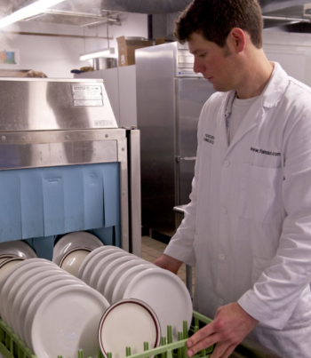


NY Stretch - power
Changes to Power:
  Requirements for regenerative drive elevators
  Commercial kitchen equipment efficiencies
Photo source: www.energystar.gov
Notes:
Good news- There are no HVAC changes in the Stretch Code for Commercial buildings. Elevator requirement is only for new construction and elevators shafts of 75’ or more. Comm. Equip. requirements align with Energy Star.

Slide 32

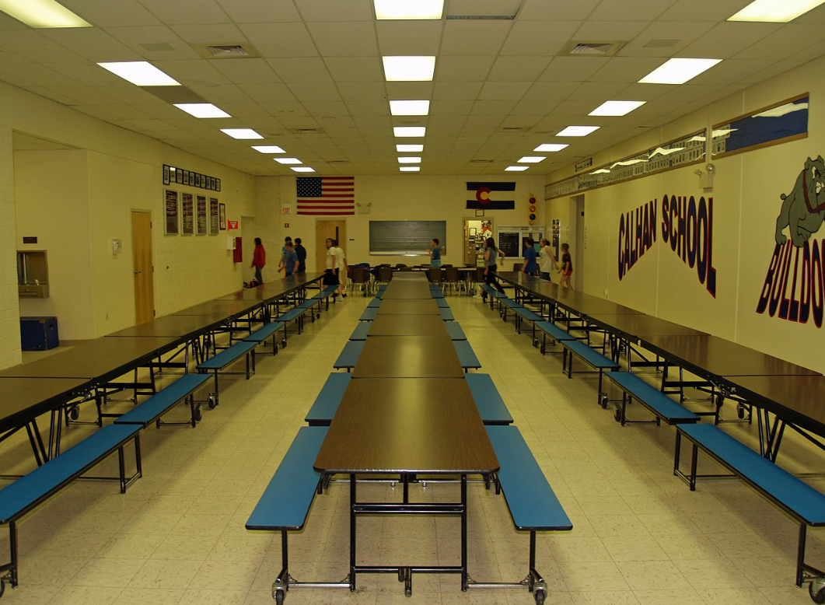
NY Stretch - lighting
Changes to the Lighting/Other:
  Reduced LPD for interior/exterior lighting
  More spaces require Occupancy sensors
      Corridors and egress illumination
      Open plan offices, cafeterias, fast-food restaurants
  High-efficiency option required for ASHRAE compliance path
Photo source: Lighting Resource Guide, www.energycodes.gov,
Photo source: Wikipedia, David Shankbone
Notes:
These LPD values were developed for ASHRAE Standard 189.1 and are significantly less than the current code requirements.

Slide 33
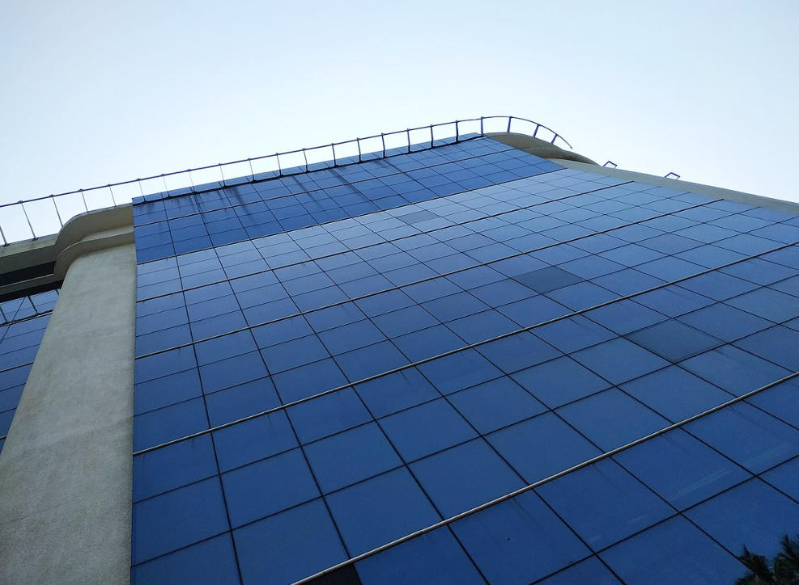
NY Stretch - modeling
Changes for energy modeling path:
  Envelope backstop
      -15% allowance for Multifamily, Dormitory
      -7% allowance for all other
    Submission requirements include ComCheck + EN1
  Source energy allowed
Photo source: Wikipedia Commons
Notes:
Only under Appendix G, conversion metrics came from NYSERDA. Cogen can only take credit for their recovered energy.

Slide 34
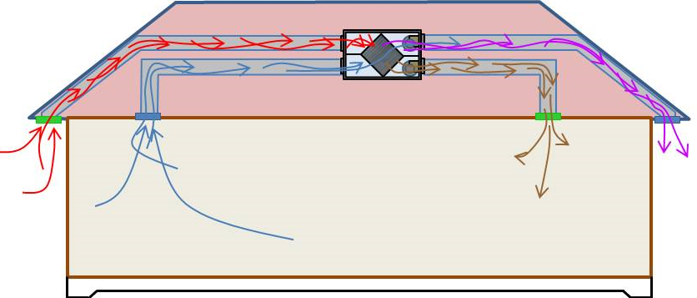
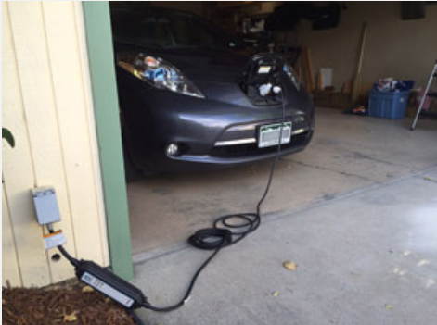
NY Stretch - residential
Major changes for residential code:
  Balanced mechanical ventilation or energy recovery
  Ventilation verification testing
  All ducts within conditioned space
  Electric Vehicle Ready
Photo source: US Department of Energy
Photo source: US Department of Energy

Slide 35
New Provisions
Adopted from the NYC Energy Code Advisory Committee

Slide 36
Nyc - envelope
Summary of Proposed changes:
  More stringent U-factors for fenestration
      Different requirements for below 95’
  New look-up table for spandrel panel assemblies
  Expanded Air Barrier Testing to 10,000 sqft
  Thermal bridging documentation

Slide 37
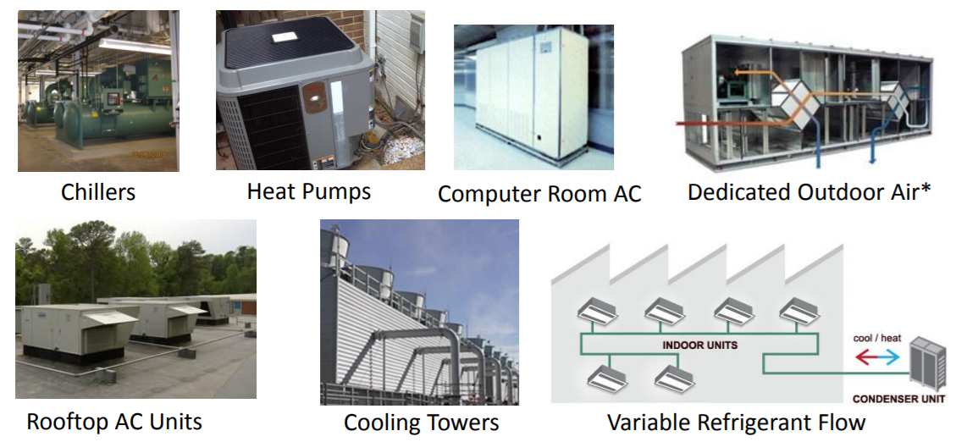
Nyc - HVAC
Changes to HVAC:
  Update to federal efficiency standards
  “Additional Energy Efficiency Options” – removal of renewable energy

Slide 38
Nyc - HVAC
Condensing boilers designed to operate in high efficiency mode
      Applies only to gas-fired hot water boilers
      Only new construction applications
If E_{t} > 90% @ rated conditions,
RWT < 120°F

Slide 39
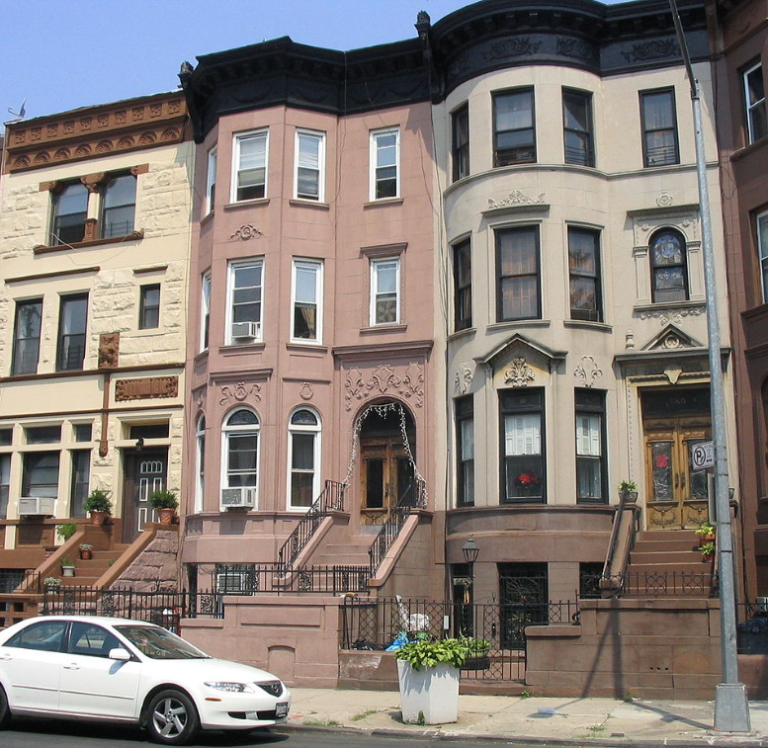
Nyc - residential
Group R-3 buildings, > 3 stories
NYC added the following requirements:
      Permanent certificate
      Air leakage testing
      Balanced ventilation or Energy Recovery
Photo source: Wikipedia Commons

Slide 40
The NYCECC of the future
Other legislation affecting the Energy Code

Slide 41
NYCECC of the future
Local Law 32 of 2018:
  Mandates that we adopt the next version (2023) of the NYStretch Code
  Requires that the 2025 Code is based on predicted energy use, and on a to-be-determined metric (such as energy use intensity, or EUI, or carbon)

Slide 42

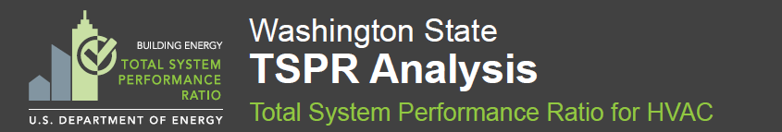
Ongoing research
Performance Pilot Program
  Funded by US DOE, managed by PNNL
  Systems-based Performance
    Envelope: COMcheck with stable baseline
    HVAC: TSPR
    Lighting: Excel based tool
  Phase 1 – Ended Fall 2021
  Phase 2 – Starting Spring 2022 – ENROLL!!!
            Email: EnergyCodePilot@buildings.nyc.gov
New York City

Slide 43
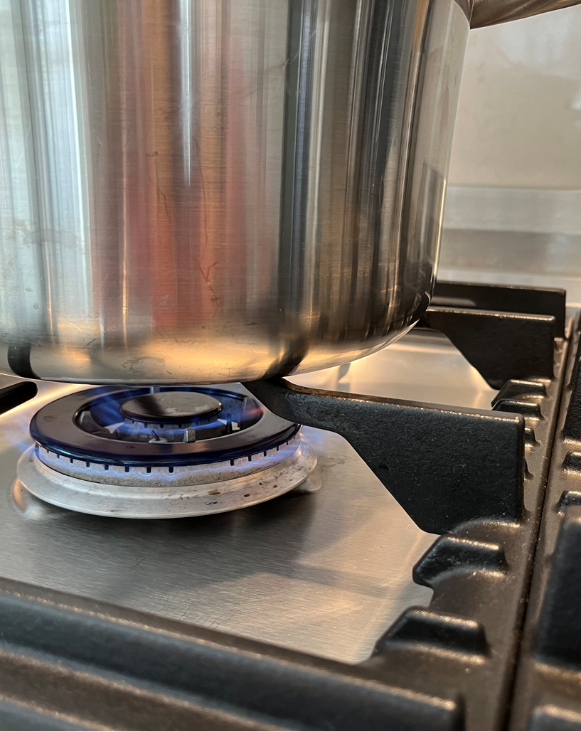
NYC Building ELECTRIFICATION LAW

Slide 44
Gina Bocra, RA
Gina Bocra, RA, LEED Fellow, is Chief Sustainability Officer at the New York City Department of Buildings (DOB). She brings over two decades of experience in sustainable design.
Prior to joining the DOB team, Gina was the former Director of Sustainability at the international firm, Burt Hill, and subsequently with Ennead Architects – where, between the two firms, she led or consulted on nearly five dozen LEED registered or certified projects.
Gina has continuously volunteered with the US Green Building Council (USGBC) since 1997, assisting with the technical development of multiple LEED rating systems, serving as a Subject Matter Expert on three LEED exams, and was a Founding interim-officer of the National Capital Region USGBC Chapter. She currently serves as the past-Chair of the LEED Steering Committee. Gina also serves as a Board Member with the Alliance for National and Community Resilience, and is a member of the US Green Building Council Advisory Council, representing local government members. In 2018, she became a member of the AIA Energy Leadership Group and joined the AIA Strategic Council Class of 2021.
At the Department of Buildings, Gina is working on implementation of New York City’s One City Built to Last Plan, supporting the laws designed to address benchmarking, energy codes, audits and retro-commissioning, and lighting and sub metering, while also contributing to new legislation to increase energy efficiency in New York City’s building stock. She leads a DOB team of specialists charged with developing procedures to enforce the Energy Code, and supports continued development of the New York City Building Code to accommodate advances in sustainability. She also serves as the Chair of the Local Law 97 Advisory Board.
Gina is a licensed architect in New York and Virginia.

Slide 45
NYC Building ELECTRIFICATION LAW
Intro.2317- Carbon limits for fuel-combustion, signed by Mayor de Blasio and enacted as Local Law 154 of 2021
  Portions of the law are contained in two sections of the City Administrative Code:
    Title 24 (NYC Air Pollution Control Code, administered by DEP)- sets the limit and the fines
    Title 28 (NYC Construction Codes, administered by DOB)- sets scope
Notes:
Introduced by Alicka Ampry-Samuel, this bill is a proposal that moves to phase out high CO2-emitting equipment from new buildings, with exceptions.

Slide 46
NYC Building ELECTRIFICATION LAW
Local Law 154 of 2021 (continued)
  Prohibits on-site combustion of fuels that emit more than 25kg CO₂/MMBTU
    New Buildings under 7 stories beginning January 1, 2024
    New Buildings 7 stories and over beginning July 1, 2027
    Exception for hot water systems in buildings less than seven stories until July 1, 2027, other than 1,2,3 family homes (Group R-3)
    Be aware of Section 101.4.5 of the Administrative Code, which covers alterations that must be filed as “New Buildings” (See Bulletin 2016-012)
Notes:
For reference, Nat Gas is 53kg CO2/MMBTU. Be aware of Section 101.4.5, projects that increase the surface area of the building by more than 110%

Slide 47
NYC Building ELECTRIFICATION LAW
Local Law 154 of 2021 (continued)
  Exceptions for Affordable Housing:
    New Buildings with 50% affordable dwelling units under 7 stories beginning January 1, 2026
    New Buildings with 50% affordable dwelling units 7 stories and over beginning January 1, 2028

Slide 48
NYC Building ELECTRIFICATION LAW
Local Law 154 of 2021 (continued)
  Other exceptions:
    Buildings used by a regulated utility for energy generation
    Buildings operated by DEP for treatment of sewage or food waste
    New buildings constructed by the School Construction Authority filed prior to January 1, 2025

Slide 49
NYC Building ELECTRIFICATION LAW
Local Law 154 of 2021 (continued)
  Other exceptions:
    Buildings in which fossil fuels are necessary for a manufacturing use or purpose
      Laboratories
      Laundromats
      Hospitals and Crematoria
      Commercial Kitchens
      For emergency or standby power

Slide 50
NYC Building ELECTRIFICATION LAW
Local Law 154 of 2021 (continued)
  Future studies required by June 1, 2023:
    Heat pump feasibility Study in low-rise and high-rise buildings
    Grid Reliability and Resiliency Study

Slide 51
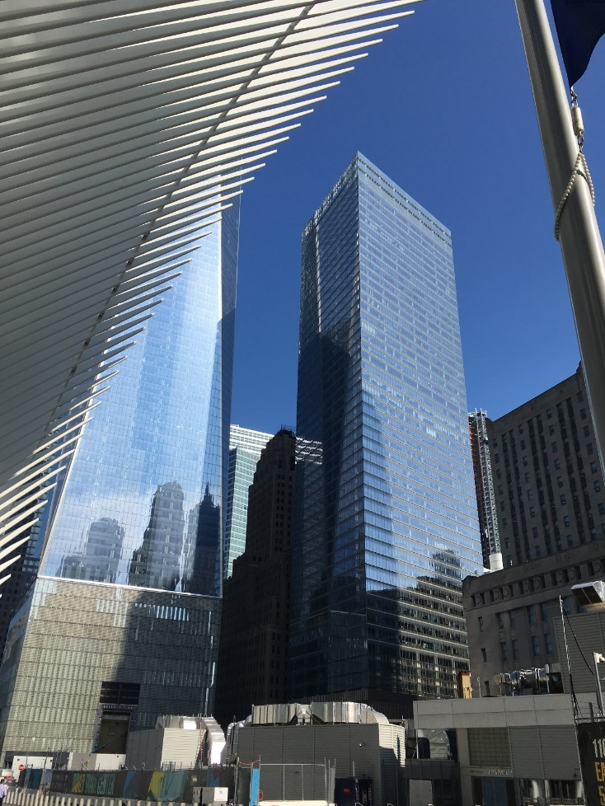
LL97 Updates
What has happened since 2019?:
Advisory Board
Working Groups
Topics to be addressed this year in Rulemaking
Topics under investigation

Slide 52
LL97 Advisory Board
Appointees
Architects
Engineer
Building Owner
Public Utility
Environmental Justice Representatives
Environmental Advocacy Organization Representative
Stationary Engineer
Construction Trades Representatives
Residential Tenant Representative
Non-profit Representative
Speaker and Mayor Designees
Chair

Slide 53
LL97 advisory board
Eight Working Groups
Commercial Building Technology & Pathways
Multi-family Building Technology & Pathways
Carbon Accounting
Energy Grid
Communications
Hospitals
Economic Impact
Implementation

Slide 54
LL97 Advisory board & Working Groups
Topics required to be addressed in Rulemaking prior to January 1, 2023
GHG Coefficient for Natural Gas Fuels Cells for 2024 – 2029
Future GHG limits for 2035 – 2050 and beyond
GHG Coefficients for all energy sources for 2030 – 2034, including electricity, fuels, and other energy sources including but not limited to DER

Slide 55
LL97 Advisory board & Working Groups
Topics of the work
Tenant-controlled energy
Adjustments to the metrics
Alternative Compliance Paths
Renewable Energy Credits
Carbon Trading
Future GHG limits for 2030 – 2034
Potential changes to LL87 of 2009
Achieving reductions from hospital buildings
Incentives for peak-demand and electrification

Slide 56
LL97 Advisory board & Working Groups
Topics of the work
Reporting requirements beyond Energy Star Portfolio Manager using DOBNOW
Mapping of Energy Star Portfolio Manager property types to the limits in the law (adds rigor and equity to the distribution of responsibility for carbon reductions)
Reporting requirements for Article 321
Reporting requirements for Campus properties
  Multiple buildings on a lot
  Buildings that share systems
Deductions
RECs
GHG Offsets

Slide 58
Contact Information
NYS Department of State
Division of Building Standards and Codes
99 Washington Avenue Suite 1160
Albany, NY 12231
P 518-474-4073
www.dos.ny.gov
NYSDOD Codes Division: Codes@dos.ny.gov
Join our mailing list:
http://www.dos.ny.gov/
New York City Department of Buildings
Sustainability Unit
280 Broadway 7th Floor
New York, NY 10007
P 212-566-5000
NYC Energy Code: energycode@buildings.nyc.gov
LL97: GHGemissions@buildings.nyc.gov
Energy Code Pilot Program: EnergyCodePilot@buildings.nyc.gov

